Slide 1
A Convolutional Encoder Model
for Neural Machine Translation
Jonas Gehring, Michael Auli, David Grangier, Yann N. Dauphin Facebook AI Research
2020-02-20
JuHyoung Kim
kjhkjh75@naver.com

Slide 2
-INTRODUCTION
NMT is an end-to-end approach to machine translation
The most successful approach to date encodes the source sentence with
A bi-directional RNN
1) variable length representation
2) generates the translation left-to-right with another RNN
where both components interface via a soft-attention mechanism.
There are some attempts to use convolutional encoder
but only applied to rescoring n-best lists of classical systems
or were not competitive to recurrent alternatives
Convolutional networks operate over a fixed-size window of the input sequence which enables the simultaneous computation of all features for a source sentence.

Slide 3
-INTRODUCTION
A succession of convolutional layers provides a shorter path to capture relationships between elements of a sequence compared to RNNs
In CNN, all words undergo the same number of transformations,
Whereas, RNNs the first word is over-processed and the last word is only once

Slide 4
- Recurrent Neural Machine Translation.
General architecture follows the encoder-decoder approach with attention
A source sentence x = (x1,…,xm) of m words is processed by an encoder
RNN network that computes a new hidden state Si+1 based on the previous state si, an embedding gi of the previous target language word

Slide 5
- Non-recurrent Encoders.
Pooling Encoder
A simple baseline for non-recurrent encoders is the pooling model described in (Ranzato et al) averages the embeddings of k consecutive words.
Averaging word embeddings does not convey positional information besides that the words in the input are somewhat close to each other.
As a remedy, add position embeddings to encode the absolute position of each source word within a sentence.
Each source embedding ej therefore contains a position embedding lj as well as the word embedding wj,.
Position embeddings have also been found helpful in memory networks for question-answering and language modeling.

Slide 6
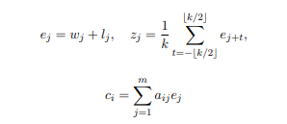
- Non-recurrent Encoders.
Similar to the recurrent encoder, the attention scores aij are computed from
pooled representations zj, however, the condtional input ci is a weighted
sum of the embeddings ej,not zj, i.e.,
Input sequence is padded prior to pooling such that the encoder output matches the input length |z| = |x|.

Slide 7
- Convolutional Encoder
A straightforward extension of pooling is to learn the kernel in a convolutional neural network(CNN)
The encoder output zj contains information about a fixed-sized context depending on the kernel width k but the desired context width may vary.
This can be addressed by stacking several layers of convolutions followed by non linearities : additional layers increase the total context size while non-linearities can modulate the effective size of the context as needed.
To ease learning for deep encoders, add residual connections from the input of each convolution to the output and then apply the non-linear activation function to the output
The non-linearities are therefore not ‘bypassed’.
Multi-layer CNNs are constructed by stacking several blocks on top of each other

Slide 8

- Convolutional Encoder
Thee CNNs do not contain pooling layers which are commonly used for down-sampling.
The full source sequence length will be retained after the network has been applied.
Similar to the pooling model, the convolutional encoder uses position embeddings.
The final encoder consists of two stacked convolutional networks
CNN-a produces the encoder output zj to compute the attention
scores ai, while the conditional input ci, to the decoder is computed
by summing the outputs of CNN-c,

Slide 9
- Convolutional Encoder
Thee CNNs do not contain pooling layers which are commonly used for down-sampling.
The full source sequence length will be retained after the network has been applied.
Similar to the pooling model, the convolutional encoder uses position embeddings.
The final encoder consists of two stacked convolutional networks
CNN-a produces the encoder output zj to compute the attention
scores ai, while the conditional input ci, to the decoder is computed
by summing the outputs of CNN-c,

Slide 10
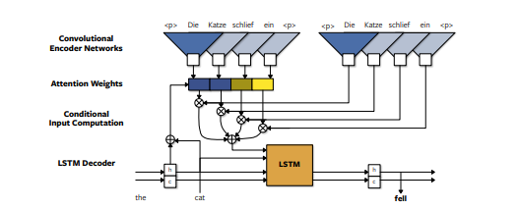
- Convolutional Encoder
Neural machine translation model with single-layer convolutional encoder networks. CNN-a is on the left and CNN-c is at the right. Embedding layers are not shown.

Slide 11
- Related work
Several past attempts to use convolutional encoders for neural machine translation, however, none of them were able to match the performance of Recurrent encoders.
(Kalch-brenner and Blunsom, 2013)
a convolutional sentence encoder in which a multi-layer CNN generates a fixed sized embedding for a source sentence, or an n-gram representation followed by transposed convolutions for directly generating a per-token decoder input.
- Latter requires the length of the translation prior to generation and both models were evaluated by rescoring the output of an existing translation system

Slide 12
- Related work
(cho et al., 2014a)
Propose a gated recursive CNN which is repeatedly applied until a fixed-size representation is obtained but the recurrent encoder achieves higher accuracy.
(Bahdanau et al.,2015)
Improved the model via a soft-attention mechanism but did not reconsider convolutional encoder models
(Kalchbrenner et al., 2016)
Introduced convolutional translation models without an explicit attention mechanism but their approach does not yet result in state-of-the-art accuracy
(Lamb and Xie, 2016)
Proposed a multi-layer CNN to generate a fixed-size encoder representation but their work lacks quantitative evaluation in terms of BLEU

Slide 13
- Related work
(Meng et al. 2015) and (Tu et al., 2015)
Applied convolutional models to score phrase-pairs of traditional phrase-based and dependency-based translation models
(pham et al., 2016)
Convolutional architectures have also been successful in language modeling but so far failed to outperform LSTMs

Slide 14
- Experiment Setup
1. Datasets
1) WMT`16 English-Romanian
2) WMT`15 English-German
3) WMT`14 English-French
Model parameters
- 512 hidden units for both recurrent encoders and decoders.
- reset the decoder hidden states to zero between sentences.
- For the convolutional encoder,512 hidden units are used for each layer in CNN-a, while layers in CNN-c contain 256 units each.
- All embeddings, including the output produced by the decoder before the final linear layer, are of 256 dimensions.
- Find that can improve the performance of the bidirectional LSTM models by using 512 dimensional word embeddings.

Slide 15
- Experiment Setup
2. Model parameters
- Model weights are initialized from a uniform distribution within [- 0.05,0.05].
- Use a uniform distribution of [-kd^-0.5, kd^-0.5], where k is the kernel
width (3) and d is the input size for the first layer and the number of hidden units for subsequent layers.
-For CNN-c, transform the input and output with a linear layer each to
match the smaller embedding size

Slide 16
- Experiment Setup
3. optimization
- Recurrent models are trained with Adam
benefit from aggressive optimization.
- Step width of 3.125 * 10^-4 and early stopping based on validation
perplexity
- Non-recurrent encoders,
1) obtain best result with stochastic gradient descent(SGD)
2) annealing : use a learning rate of 0.1 and once the validation perplexity stops improving, reduce the learning rate by an order of magnitude

Slide 17
- Experiment Setup
3. optimization
- All modes
1) use mini-batches of 32 sentences
2) use truncated back-propagation through time to limit the
length of target sequences per mini-batch to 25 words.
3) Gradients are normalized by the mini-batch size.
4) re-normalize the gradients if their norm exceeds 25
5) Gradients of convolutional layers are scaled by
sqrt(dim(input))^-1.
6) use dropout on the embeddings and decoder outputs hi,
with a rate of 0.2 for IWSLT`14 and 0.1 for WMT
7)All models are implemented in Torch(Collobert et al,2011a)
and trained on a single GPU

Slide 18
- Experiment Setup
4. Evaluation
- report accuracy of single systems by training several identical models
with different random seeds(5 for IWSLT`14, 3 for WMT) and pick the
one with the best validation perplexity for final BLEU evaluation.
- Translation are generated by a beam search and we normalize
log-likelihood scores by sentence length.
- IWSLT`14 beam width 10
- WMT models tune beam width and word penalty on a separate test set
- The word penalty adds a constant factor to log-likelihoods, except
for the end-of-sentence token.

Slide 19
- Experiment Setup
4. Evaluation
- prior to scoring the generated translations against the respective
references, perform unknown word replacement based on attention
scores.
- Unknown words are replaced by looking up the source word with
the maximum attention score in a pre-computed dictionary.
- If the dictionary contains no translation, then we simply copy the
source word.
- Dictionaries were extracted from the aligned training data that was
aligned with fast_align.
- Each source word is mapped to the target word it is most frequently
aligned to

Slide 20
- Experiment Setup
4. Evaluation
- Convolutional encoders with stacked CNN-c layers we noticed for
some models that the attention maxima were consistently shifted by
one word.
- determine this per-model offset on the abovementioned development sets and correct for it
- Finally, compute case-sensitive tokenized BLEU

Slide 21
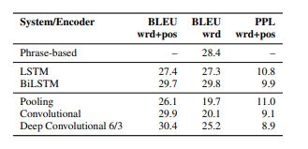
- Result
Recurrent vs Non-recurrent Encoders
- compare in terms of perplexity and BLEU on IWSLT`14
with and without position embeddings.
and include a phrase-based system.

Slide 22
- Result
Varying the number of layers in CNN-a and CNN-c between 1 and 10 and obtained best validation set perplexity with 6 layers for CNN-a and three layers for CNN-c.
굳이 쓸필요 없고 표로 보면될듯.

Slide 23
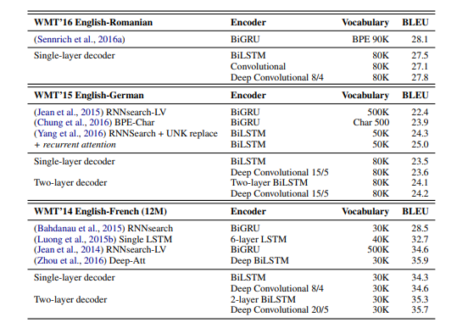
- Result
-

Slide 24
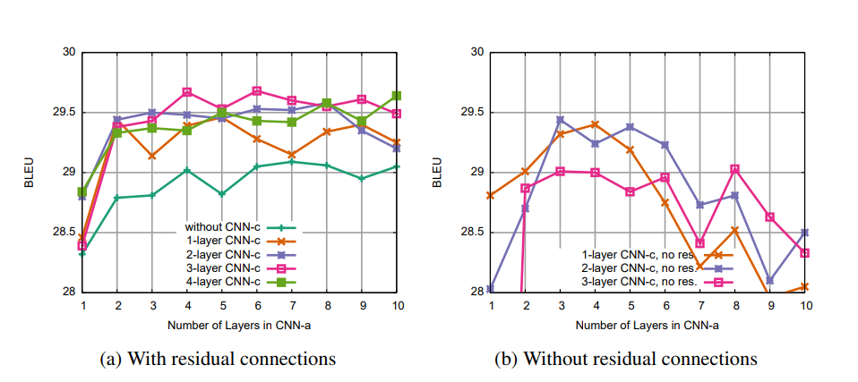
- Result
3. Convolutional Encoder Architecture Details
Use the smaller IWSLT`14 German-English setup without unknown word
replacement to enable fast experiment turn-around
- Shows accuracy for a different number of layers of both CNNs with and without residual connections.

Slide 25
- Result
3. Convolutional Encoder Architecture Details
Increasing the number of CNN-c layers is beneficial up to three layers and beyond this we did not observe further improvements.
Increasing the number of layers in CNN-a beyond six does not increase accuracy on this relatively small dataset.
Without residual connections, the model fails to utilize the increase in modeling power from additional layers, and performance drops significantly for deeper encoders
CNN-a for attention score computation ai and CNN-c for the conditional input ci to be fed to the decoder.

Slide 26
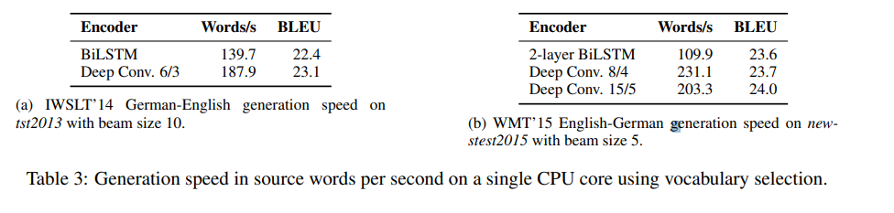
- Result
4. Training and Generation Speed

Slide 27
Conclusion
Introduced a simple encoder model for neural machine translation based on convolutional networks.
More parallelizable than recurrent networks and provides a shorter path to capture long-range dependencies in the source.
We find it essential to use source position embeddings as well as different CNNs for attention score computation and conditional input aggregation.
Experiments show the convolutional encoders perform on par or better than baselines based on bi-directional LSTM encoders.
Deep convolutional encoder is competitive to the best published results to date which are obtained with significantly more complex models or stem from improvements that are orthogonal to our work.

Slide 28
Conclusion
Leads to large generation speed improvements :
translation models with our convolutional encoder can translate twice as fast as strong baseline with bi-directional recurrent encoders
Future work includes better training to enable faster convergence with the convolutional encoder to better leverage the higher processing speed.
Architecture is interesting for character level encoders where the input is significantly longer than for words.
Plan to investigate the effectiveness of architecture on other sequence to sequence tasks

